Slide 1
STATISTICAL PROGRAMMING TEAM ALL-HANDS
SCE Modernization
Vision, Practical Roadmap, and Open-Source Adoption
Format
Target Outcome
90-Minute Interactive Workshop
Shared Vision & Working Group Invitations

Slide 2
DIAGNOSTIC & BASELINE
Current State: Reliable Engine, Real Gaps
Proven Strengths
Audit Findings & Gaps
High Stability: Decades of predictable submission deliveries.
Traceability Friction: Manual logs complicate GxP audits.
Deep Domain Mastery: Highly established legacy macros.
Version Locking: Fragile file-share copy mechanisms.
Standardized Pipelines: Familiar processes across clinical teams.
Ecosystem Silos: Blocked from modern data science toolkits.

Slide 3
STRATEGIC IMPERATIVE
Drivers: Why Modernize Right Now?
Audit Remediation
Talent Alignment
Cycle Time Velocity
Automated lineage eliminates human compliance errors.
Next-generation statisticians expect R and Python.
40% faster clinical table generation workflows.

Slide 4
TARGET ARCHITECTURE
The Next-Gen SCE Ecosystem
LAYER 01
LAYER 02
LAYER 03
LAYER 04
Cloud Compute
Polyglot IDEs
Package Manager
Git & CI/CD
Elastic containers on Kubernetes.
RStudio, VS Code, SAS Studio.
Curated, frozen CRAN & PyPI repos.
Automated qualification & audit trails.

Slide 5
EVALUATION & ALIGNMENT
Platform & Tooling Decisions
Platform / Tool | Primary Role | Core Rationale | Transition Impact
R & pharmaverse | Clinical TLGs & ADaM | Community-backed standards | High efficiency gains
Python | AI, NLP & Data Prep | Rich ML library ecosystem | Accelerated automation
Git / GitHub Enterprise | Source Code Management | Immutable audit records | Resolves audit gaps
SAS Interoperability | Legacy Study Maintenance | Zero disruption to active submissions | Zero transition shock

Slide 6
EXECUTION PLAN
Four-Stage Modernization Roadmap
Q1-Q2
Q3
Q4
Next Year
Stage 1: Design
Stage 2: Pilot
Stage 3: Scale
Stage 4: Standard
Container infra validation and package repo setup.
Dual-run programming on non-critical study cohorts.
Team-wide Git migration and pharmaverse reporting.
Open-source first for all upcoming submission pipelines.

Slide 7
INDUSTRY MOMENTUM
Regulatory & Peer Adoption
100%
50+
FDA Pilot Submissions Accepted
Pharma Companies in pharmaverse
FDA R Submissions Working Group milestone
Collaborative clinical reporting standards

Slide 8
CLARITY & CONFIDENCE
Open-Source: Myth vs. Fact
"Regulators require submissions coded only in SAS."
FDA guidance explicitly states no software endorsement.
MYTH
FACT
"Open source cannot satisfy 21 CFR Part 11 validation."
R Validation Hub framework ensures rigorous qualification.
MYTH
FACT
"We must discard all existing SAS programs overnight."
Both run side-by-side in a hybrid coexistence model.
MYTH
FACT

Slide 9

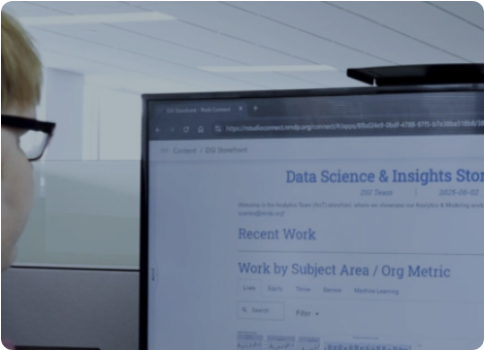
RISK MITIGATION
Phased Migration: Zero Disruption
Dual-Programming Verification
Primary in SAS, validation in R for pilot tables.
Curated Internal Libraries
Approved, pre-qualified packages with frozen versions.
Study-Level Opt-In
No in-flight clinical studies forced mid-stream.

Slide 10
NEXT HORIZONS
AI & Workflow Automation
Assisted Coding
Automated Linting
Agentic Workflows
GitHub Copilot for boilerplate TLG logic.
Instant syntax verification on commit.
Auto-generating Define-XML and spec checks.

Slide 11
PEOPLE & ENABLEMENT
Skill Building: No Programmer Left Behind
TRACK A
TRACK B
TRACK C
R for SAS Programmers
Modern Git Workflows
Hackathons & Sandboxes
Hands-on tidyverse and pharmaverse syntax.
Branching, pull requests, and peer reviews.
Safe sandbox environments to test real code.

Slide 12
CALL TO ACTION
Join the SCE Modernization Working Groups
We need study leads, core programmers, and reviewers. Commit 2 hours per week to co-build our platform.
WG 1: Open-Source Tooling
WG 2: Validation & Quality
WG 3: Training & Enablement
Questions & Open Discussion

Slide 13

Image Sources
https://posit.co/sites/default/files/styles/small_hq/public/image/2026-04/NMPD.png?itok=LXfxd0pe
Source: posit.co

